Slide 1
Schizophrenia Disease Prediction using face
Team No: ECE063
Team Members:
Mohan V | CB.EN.U4CCE20033
Nithin Rajaseharan | CB.EN.U4CCE20039
Taushiq Balamurugan | CB.EN.U4CCE20064
Varun S | CB.EN.U4CCE20069

Slide 2
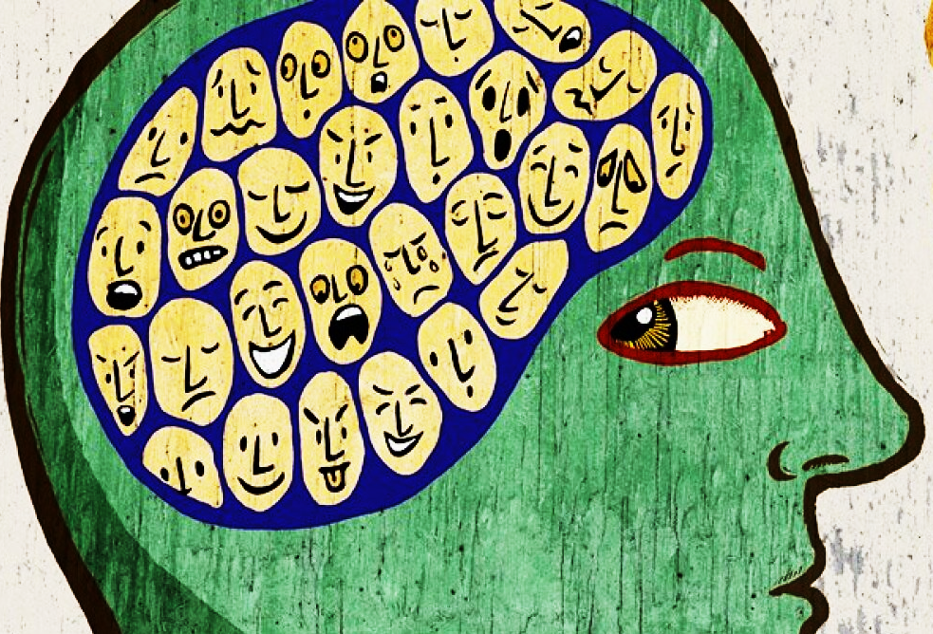
Introduction
Schizophrenia people interpret reality abnormally.
They show a markedly reduced ability to perceive and express facial emotions.
Patients experience a range of symptoms, including hallucinations, delusions, disorganized thinking, and emotional disturbances.
According to WHO, 20 million people worldwide have schizophrenia.

Slide 3
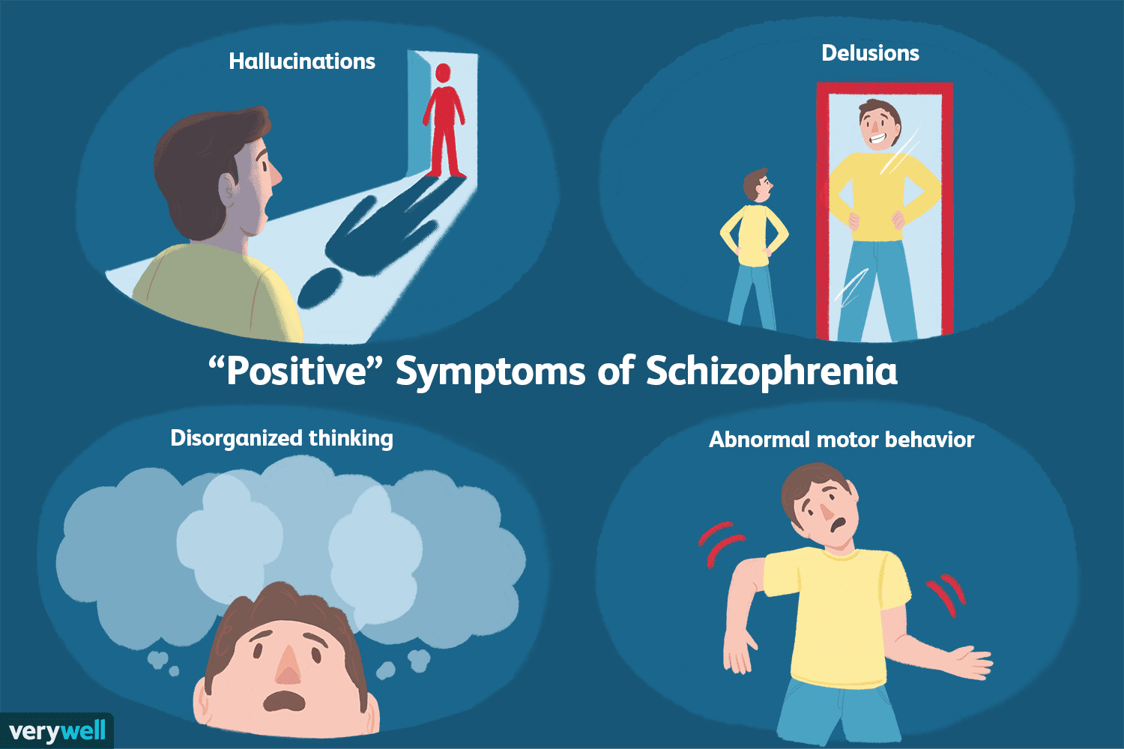
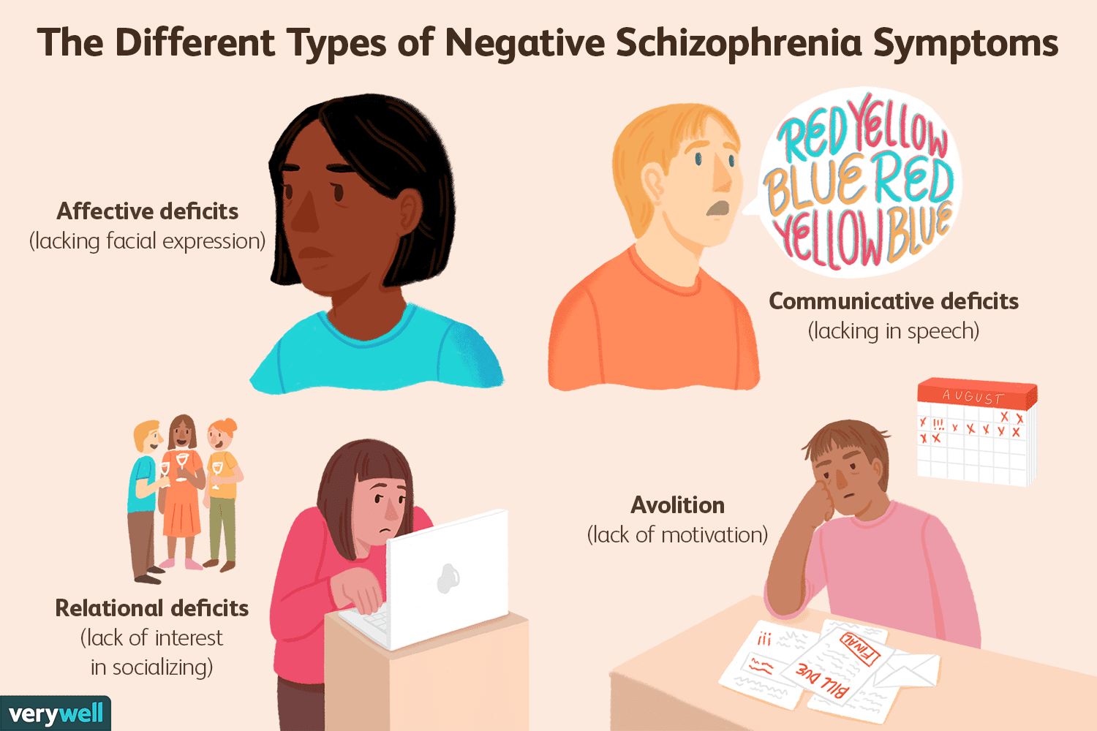
Introduction

Slide 4
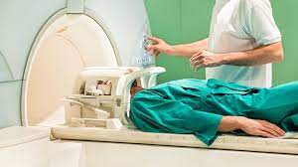
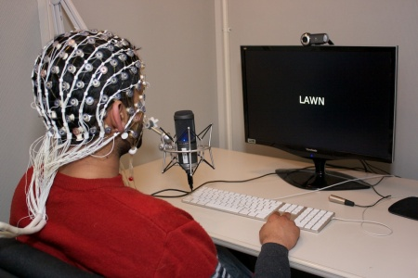
Problem statement
The schizophrenia diagnosis relies on the subjective evaluation of clinical symptoms by a psychiatrist.
No clear organic indicators have been identified.
MRI scanning method and EEG signal method is invasive.
Due to the lack of quantitative standards and the reliance on subjective evaluation from psychiatrists, misdiagnosis of schizophrenia occurs.

Slide 5
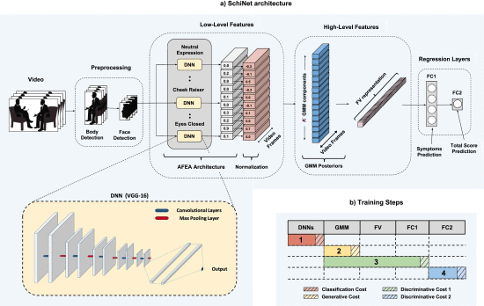
Literature Survey – BASe PAPER
Title: SchiNet: Automatic Estimation of Symptoms of Schizophrenia from Facial
Behaviour Analysis
Publication: IEEE Transactions on Affective Computing (2019) (Journal)
Inference:
SchiNet, a novel neural network architecture that estimates expression-related symptoms
Videos of professional-patient interviews were used
Detected facial expressions are significantly correlated to symptoms of schizophrenia

Slide 6
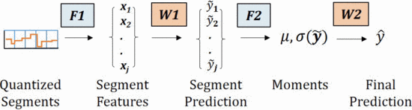
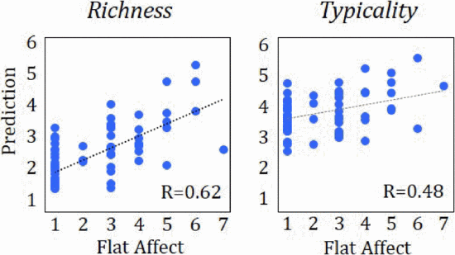
Literature Survey – Reference PAper
Title: Facial expressions and flat affect in schizophrenia, automatic analysis from
depth camera data
Publication: IEEE-EMBS International Conference on Biomedical and Health
Informatics (BHI) (2016)
Inference:
Prominent feature of schizophrenia is flat facial activity
Dedicated software to automatically measure the facial activity of schizophrenia patients
K-means clustering analysis of 7 facial-clusters.
85% correct diagnosis classification rate in a SVM based two-step algorithm
Significant correlation with Flat Affect severity.

Slide 7
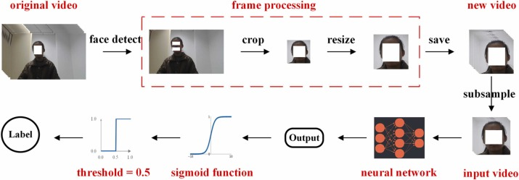
Literature Survey – Reference PAper
Title: Automatic recognition of schizophrenia from facial videos using 3D convolutional
neural network
Publication: Asian Journal of Psychiatry 77 (2022) (Elsevier)
Inference:
Preprocessed facial videos were used to train the Resnet18_3D
Dynamic changes in the facial region is a marker of schizophrenia
Resnet18_3D achieved 89% accuracy.

Slide 8
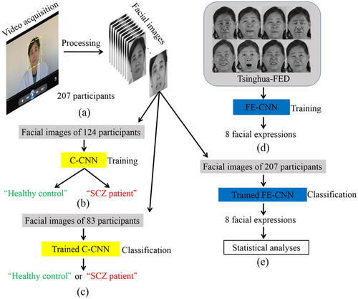
Literature Survey – Reference PAper
Title: Recognizing schizophrenia using facial expressions based on convolutional
neural network
Publication: Brain and Behavior (2023)
Inference:
To investigate objective differences in facial expressions between SCZ patients and healthy controls using deep learning algorithm and statistical analyses.
The video data was used
The trained CNN achieved an overall accuracy of 95.18% for classifying “healthy control” or “SCZ patient.”

Slide 9
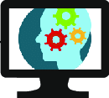
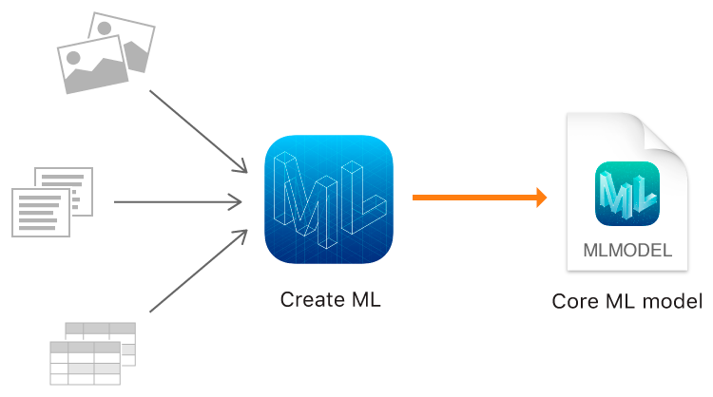
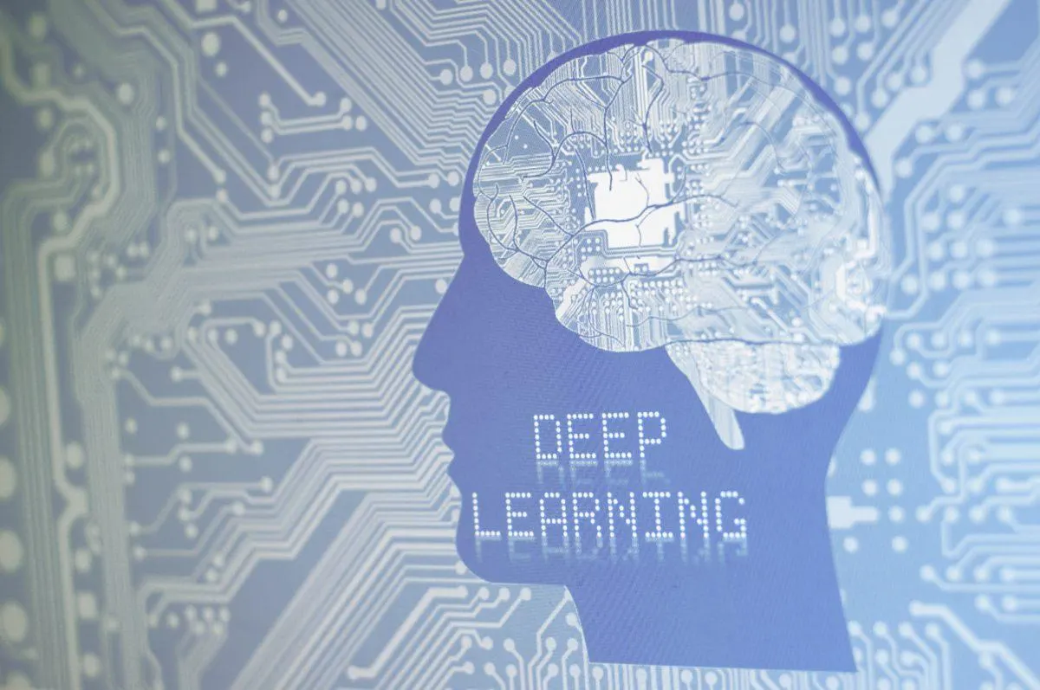
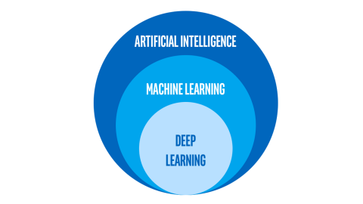
Objectives
Computer-Aided Diagnosis (CAD) system for schizophrenia
detection using face
Implementation of ML model for the creation of hand-crafted
features
Implementation of DL model
Implementation of CAD model by integrating of both ML and DL
model

Slide 10
Proposed IDEA
A
A
A

Slide 11
Proposed IDEA
A
A
A

Slide 12
REferences
Bishay, Mina, et al. "Schinet: Automatic estimation of symptoms of schizophrenia from facial behaviour analysis." IEEE Transactions on Affective Computing 12.4 (2019): 949-961. doi: https://doi.org/10.1109/TAFFC.2019.2907628
Tron, Talia, et al. "Facial expressions and flat affect in schizophrenia, automatic analysis from depth camera data." 2016 IEEE-EMBS International Conference on Biomedical and Health Informatics (BHI). IEEE, 2016. doi: https://doi.org/10.1109/BHI.2016.7455874
Huang, Jie, et al. "Automatic recognition of schizophrenia from facial videos using 3D convolutional neural network." Asian Journal of Psychiatry 77 (2022): 103263. dio: https://doi.org/10.1016/j.ajp.2022.103263
Zhang, Xiaofei, et al. "Recognizing schizophrenia using facial expressions based on convolutional neural network." Brain and Behavior (2023): e3002. doi: https://doi.org/10.1002/brb3.3002
Martinez, Brais, et al. "Automatic analysis of facial actions: A survey." IEEE transactions on affective computing 10.3 (2017): 325-347. doi: https://doi.org/10.1109/TAFFC.2017.2731763

Slide 13
Thank You
Team ECE063

